Slide 1
Attribute-oriented analysis
  Attribute generalization
  Attribute relevance
  Class comparison
  Statistical measures

Slide 2
Attributes
Attribute (or dimensions, features, variables): a data field, representing a characteristic or feature of a data object.
  E.g., customer _ID, name, address
Types:
  Nominal
  Binary
  Numeric: quantitative
    Interval-scaled
    Ratio-scaled
Notes:
MK 08.11.09 Former title: Data Warehouse Back-End Tools and Utilities

Slide 3
Attributes Types
Nominal: categories, states, or “names of things”
  Hair_color = {black,brown, grey, red, white}
  marital status, occupation, ID numbers, zip codes
Binary
  Nominal attribute with only 2 states (0 and 1)
Ordinal
  Values have a meaningful order (ranking) but magnitude between successive values is not known.
  Size = {small, medium, large}, grades, army rankings
Notes:
MK 08.11.09 Former title: Data Warehouse Back-End Tools and Utilities

Slide 4
Numeric Attributes Types
Quantity (integer or real-valued)
Interval
    Measured on a scale of equal-sized units
    Values have order
      E.g., temperature in C˚or F˚, calendar dates
    No true zero-point(not the complete absence )
Ratio
    Inherent zero-point(complete absence of the quantity.)
    We can speak of values as being an order of magnitude larger than the unit of measurement (10 K˚ is twice as high as 5 K˚).
      e.g., temperature in Kelvin, length, counts, monetary quantities
Notes:
MK 08.11.09 Former title: Data Warehouse Back-End Tools and Utilities

Slide 5
Discrete vs. Continuous Attributes
Discrete Attribute
  Has only a finite or countably infinite set of values
    E.g., zip codes, profession, or the set of words in a collection of documents
  Sometimes, represented as integer variables
  Note: Binary attributes are a special case of discrete attributes
Continuous Attribute
  Has real numbers as attribute values
    E.g., temperature, height, or weight
  Practically, real values can only be measured and represented using a finite number of digits
  Continuous attributes are typically represented as floating-point variables
Notes:
MK 08.11.09 Former title: Data Warehouse Back-End Tools and Utilities

Slide 6
Attribute Generalization
Purpose: Replace low-level (detailed) attribute values with higher-level concepts according to a concept hierarchy or taxonomy.
Steps:
  Identify relevant attributes.
  Apply generalization rules based on the concept hierarchy.
  Remove attributes that reach the highest abstraction level or are irrelevant.
Example:
City → State → Country
Age (23) → Age group (20–29)
Benefits:
  Reduces data size.
  Highlights general patterns.
  Improves interpretability.

Slide 7
Attribute Relevance
Definition: Determining which attributes significantly contribute to the analysis or decision-making.
Why it matters: Irrelevant attributes add noise and reduce accuracy.
Approach:
  Correlation analysis: Identify attributes correlated with the target class.
  Statistical significance tests: e.g., Chi-square, ANOVA.
  Information gain / entropy measures in classification.
Outcome: Keep only attributes that add meaningful discrimination power.

Slide 8
Class Comparison
Definition: Comparative analysis of the characteristics of different classes (or concepts) of data.
Process:
  Partition dataset into target class(es) and contrasting class(es).
  Summarize data for each class (e.g., average, percentage, distribution).
  Highlight distinguishing features.
Example:
  Compare “High-income customers” vs “Low-income customers” in terms of average spending, preferred product category, etc.
Applications:
  Marketing (customer segmentation)
  Medical diagnosis (patients with vs without a disease)

Slide 9
Statistical Measures
  Support – proportion of tuples satisfying a condition.
  Confidence – conditional probability that a tuple satisfies another condition given one condition.
  Mean, Median, Mode – central tendency.
  Variance, Standard Deviation – spread of data.
  t-test, Chi-square test – significance of attribute differences between classes.
  Correlation coefficient (r) – strength of linear relationship between attributes.

Slide 10
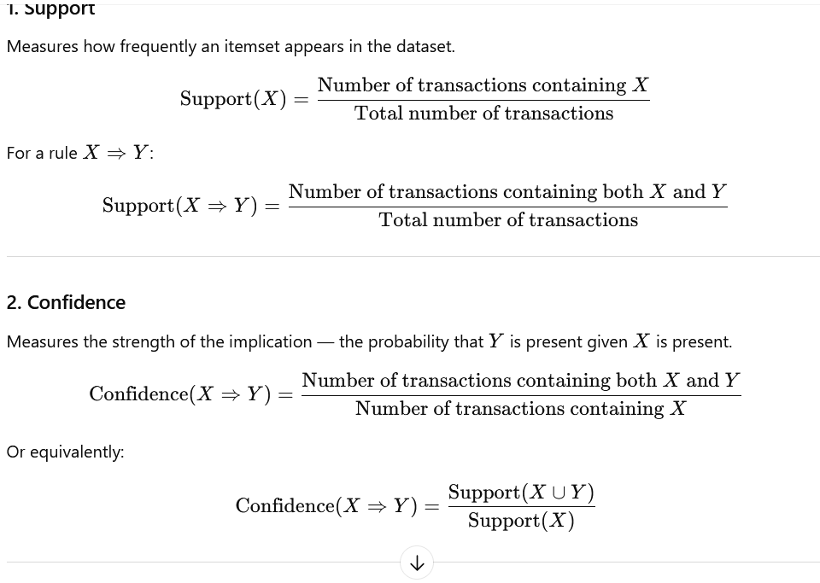
Support and Confidence

Slide 11
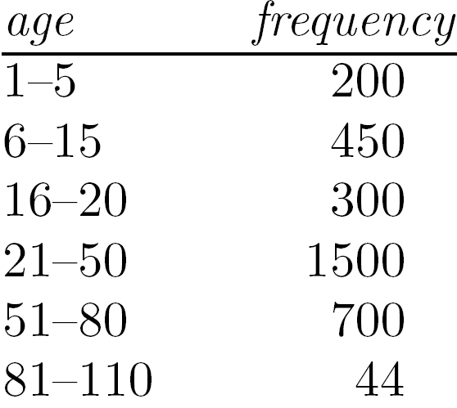
Measures of Central Tendency
Mean (algebraic measure) (sample vs. population):
  Note: n is sample size and N is population size.
  Weighted arithmetic mean:
  Trimmed mean: chopping extreme values
Median:
  Middle value if odd number of values, or average of the middle two values otherwise
  Estimated by interpolation (for grouped data):
Mode
  Value that occurs most frequently in the data
  Unimodal, bimodal, trimodal
  Empirical formula:
Mean (algebraic measure) (sample vs. population):
  Note: n is sample size and N is population size.
  Weighted arithmetic mean:
  Trimmed mean: chopping extreme values
Median:
  Middle value if odd number of values, or average of the middle two values otherwise
  Estimated by interpolation (for grouped data):
Mode
  Value that occurs most frequently in the data
  Unimodal, bimodal, trimodal
  Empirical formula:
Median interval
Notes:
MK 08.11.09 Former title: Data Warehouse Back-End Tools and Utilities

Slide 12
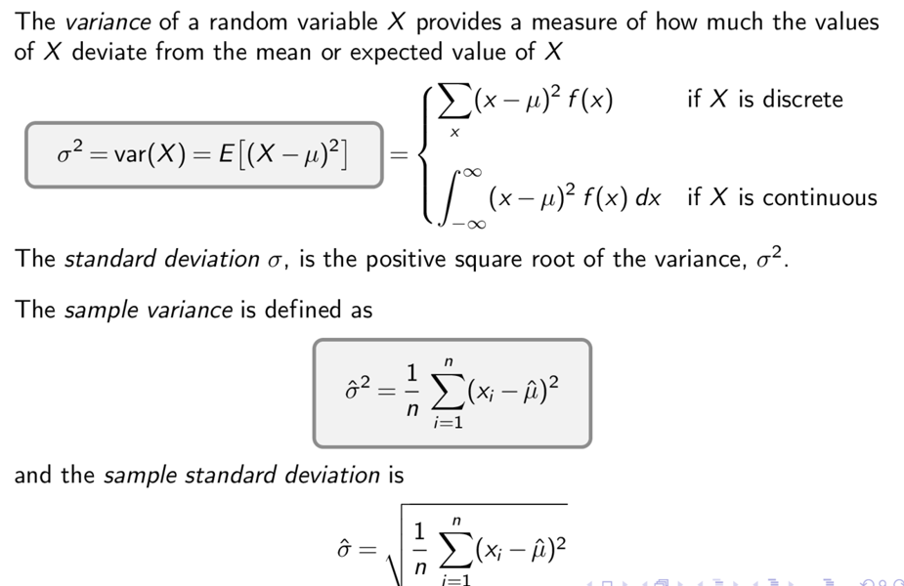
Variance and Standard Deviation
Notes:
MK 08.11.09 Former title: Data Warehouse Back-End Tools and Utilities

